Slide 1
HMM Unit 2: Posterior Probability Calculation
Gary Chen
Teresa Breyer
Sul-Min Kim

Slide 2
Implementation

Slide 3
Specifications
Requirements Spec
  Read CLUSTAL format file
  Read FASTA format file
  Output optimal alignment in CLUSTAL and the posterior probability for each column in the alignment
Functional Spec
  Generate an alignment based HMM probabilistic model profile
  Generate dynamic programming matrices based on each FASTA sequence against HMM model
  Compute optimal alignment using Viterbi and posterior probabilities using Forward and Backward Algorithm

Slide 4
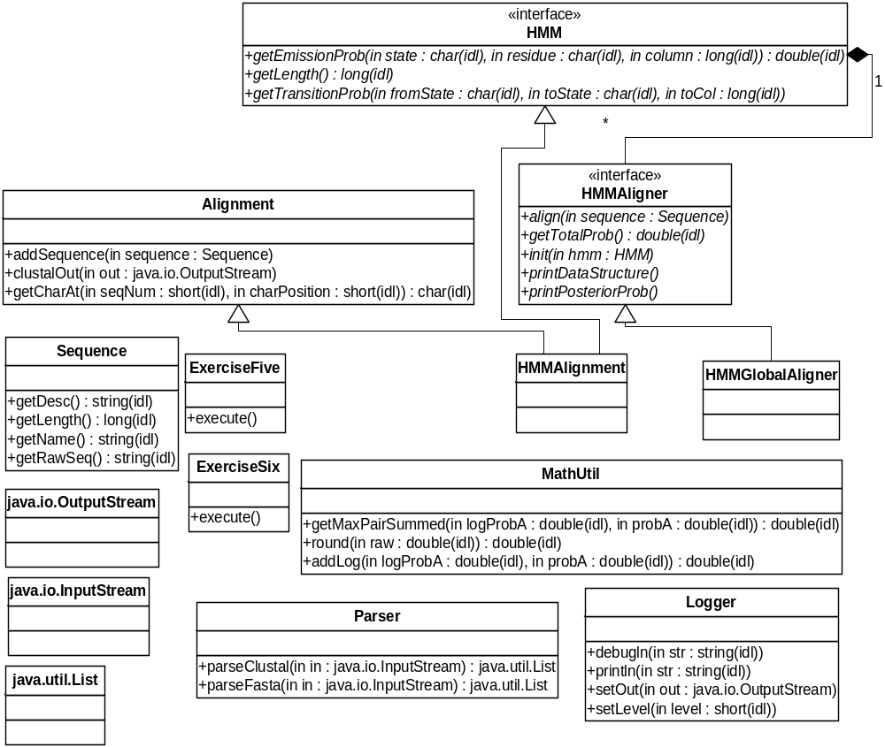
UML
Modules:
Main classes
HMM
I/O
Core objects
Java SDK

Slide 5
Function Prototypes
HMMGlobalAligner – encapsulates dynamic programming functionality between a sequence and an HMM probabilistic model
public void init(HMM hmm)
public align()
throws DataFormatException
public double getTotalProb()
throws DataFormatException
public void printDataStructure()
throws DataFormatException
public void printPosteriorProbs()
throws DataFormatException
private void computeBackwardProbs()
throws DataFormatException
private void computeForwardProbs()
throws DataFormatException
private void computeViterbiProbs()
throws DataFormatException

Slide 6
Class Cell
class Cell {
double fMatch;
double fDelete;
double bMatch;
double bDelete;
double vMatch;
double vDelete;
double pMatch;
double pDelete;
int xLoc;
int yLoc;
Cell matchTraceBack;
byte prevStateToMatch;
Cell deleteTraceBack;
byte prevStateToDelete;
}
class TerminalCell {
double totalProb;
Cell traceBack;
byte prevState;
}

Slide 7
Forward, Backward, Viterbi Formula
Backward algorithm formula:
M(i,,j)=M(i+1,j+1) * emission_{i+1}(seq(j))* transition_{Mi,Mi+1} + M(i,j+1)*emission_{i}(j+1) *transition_{Mi,Mi} +
D(i+1,j) *transition_{Mi,Di+1}
D(i,j)=.D(i+1,j) *transition_{Di,Di+1} + M(i+1,j+1)*emission_{i+1}(seq(j))*transition_{Di,Mi+1}

Slide 8
Forward, Backward, Viterbi Formula
Java implementation:
matrix[i][j].bMatch = MathUtil.addLogLog(matrix[i+1][j+1].bMatch + Math.log(myHMM.getEmissionProb(myHMM.MATCH, sequence.charAt(j), i+1)) + Math.log(myHMM.getTransitionProb(myHMM.MATCH, myHMM.MATCH, i+1)), matrix[i][j+1].bMatch + Math.log(myHMM.getEmissionProb(myHMM.MATCH, sequence.charAt(j), i)) + Math.log(myHMM.getTransitionProb(myHMM.MATCH, myHMM.INSERTION, i)), matrix[i+1][j].bDelete + Math.log(myHMM.getTransitionProb(myHMM.MATCH, myHMM.DELETION, i+1)));
matrix[i][j].bDelete = MathUtil.addLogLog(matrix[i+1][j].bDelete + Math.log(myHMM.getTransitionProb(myHMM.DELETION, myHMM.DELETION,i+1)), matrix[i+1][j+1].bMatch + Math.log(myHMM.getEmissionProb(myHMM.MATCH,sequence.charAt(j), i+1)) + Math.log(myHMM.getTransitionProb(myHMM.DELETION, myHMM.MATCH, i+1)));

Slide 9
Forward, Backward, Viterbi Formula
HMM Alignment probability for Backward Algorithm
Probability =
M_{B}(0,1) * emission₀(seq(0))* transition_{Begin,M0} +
D_{B}(0,0) *transition_{Begin,D0}

Slide 10
Forward, Backward, Viterbi Formula
Viterbi algorithm formula:
M_{V}(i, j) = emission_{i}( seq( j-1) ) * max [ M_{v}(i-1, j-1) *
transition_{Mi-1,Mj} , M_{v}(i,j-1) * transition_{Mi,Mj} , D_{v}(i-1,j-1) * transition_{Di-1,Dj}]
D_{v}(i,j) = max(M_{v}(i-1,j) * transition_{Mi-1,Dj} ,
D_{v}(i-1,j) * transition_{Di-1,Dj})

Slide 11
Traceback
Start at terminal cell and choose the traceback with the max value
Follow the move of the current cell’s state traceback
End when you hit the begin state

Slide 12
Traceback Code: Match States
Seq: A T T
Insertions are distinguished from matches by tracking the previous match cell’s HMM column number.
 | 0 | 1 | 2
0 | B | M | D
1 | M | M | D
2 | D | M | M
HMM Columns
if(currState == HMM.MATCH){
if(currCell.yLoc>0){
prevCell = currCell.matchTraceBack;
}
// when the current cell is a MATCH state and has come from a previous cell which was in
// the SAME ROW, it is a INSERTION
if(prevCell.yLoc == currCell.yLoc){
//Logger.debugln("adding insert gapchar at "+(row));
hA.addInsertAtCol(row);
Logger.debugln("while loop: INSERT: row,col = "+currCell.yLoc+","+currCell.xLoc+"pMatch:"+currCell.pMatch);
output.push(" LETTER:"+sequence.charAt(col-1)+"\tPROB="+
MathUtil.round( Math.exp( currCell.pMatch - probBaseE ) * 100 ) +"%");
}
else{
//Logger.debugln("adding match at "+(row));
Logger.debugln("while loop: MATCH: row,col = "+currCell.yLoc+","+currCell.xLoc+" pMatch:"+currCell.pMatch);
output.push(" LETTER:"+sequence.charAt(col-1)+"\tPROB="+
MathUtil.round( Math.exp( currCell.pMatch - probBaseE ) * 100 ) +"%");
}

Slide 13
Traceback Code: Deletion States
if(currState == HMM.DELETION){
//Logger.debugln("adding delete gapchar at "+(col-1));
hA.addDeleteAtCol(col-1);
Logger.debugln("while loop: DELETION: row,col = "+currCell.yLoc+","+currCell.xLoc+" pDel: "+currCell.pDelete );
output.push(" LETTER:"+Alignment.GAP_CHAR+"\tPROB="+
MathUtil.round( Math.exp( currCell.pDelete - probBaseE ) * 100 ) +"%");

Slide 14
Testing and Other Weird Stuff

Slide 15
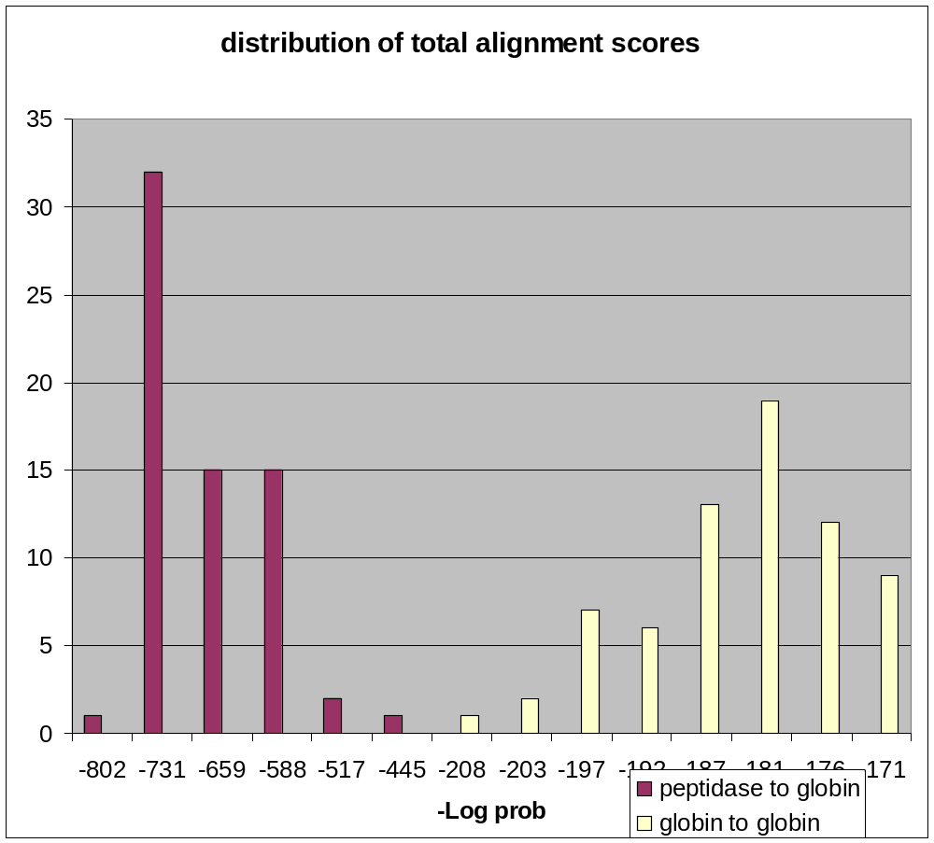
Globins

Slide 16
Weird Stuff
COLUMN:1 LETTER:A PROB=96.94%
COLUMN:2 LETTER:A PROB=18.92%
COLUMN:3 LETTER:A PROB=34.18%
COLUMN:4 LETTER:G PROB=48.65%
COLUMN:5 LETTER:T PROB=64.26%
COLUMN:6 LETTER:T PROB=78.12%
COLUMN:7 LETTER:T PROB=96.94%
CLUSTAL W (1.74) multiple sequence alignment
Seq1 A-AATTT
seq2 A-AATTT
Seq3 A-AATTT
seq4 A-AATTT
Seq5 A-AATTT
seq6 A-AATTT
tst1 AAAGTTT
COLUMN:1 LETTER:A PROB=99.09%
COLUMN:2 LETTER:A PROB=81.79%
COLUMN:3 LETTER:A PROB=66.04%
COLUMN:4 LETTER:G PROB=49.64%
COLUMN:5 LETTER:T PROB=33.61%
COLUMN:6 LETTER:T PROB=17.36%
COLUMN:7 LETTER:T PROB=99.09%
CLUSTAL W (1.74) multiple sequence alignment
Seq1 AAATTT-
seq2 AAATTT-
Seq3 AAATTT-
seq4 AAATTT-
Seq5 AAATTT-
seq6 AAATTT-
Seq11 AAATTT-
seq21 AAATTT-
Seq31 AAATTT-
seq41 AAATTT-
Seq51 AAATTT-
seq61 AAATTT-
tst1 AAAGTTT

